Slide 1
Естествознание
Тема: Части тела человека

Slide 2
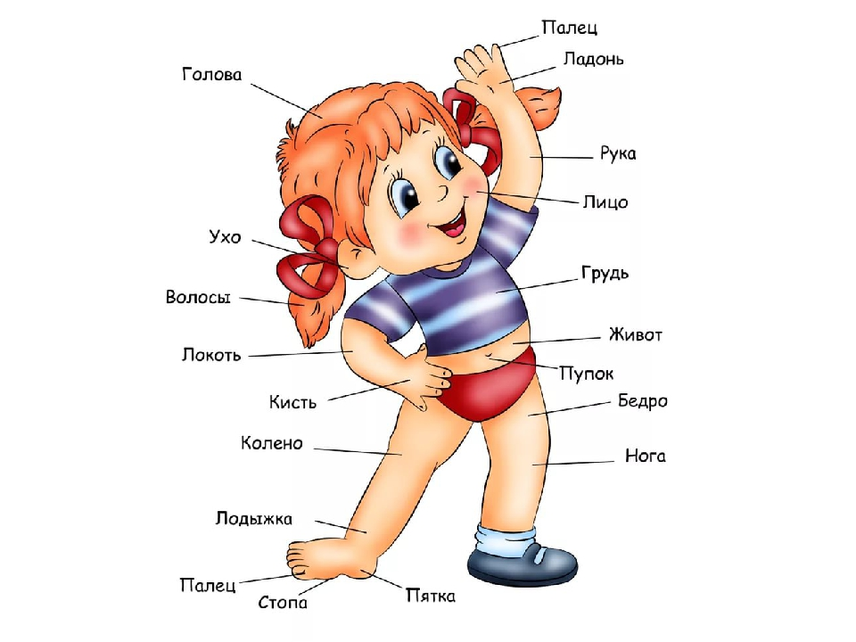

Slide 3
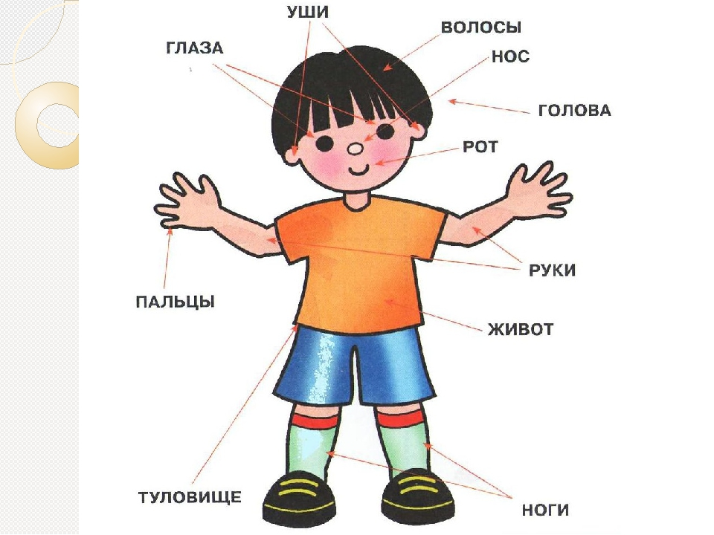

Slide 4

.ттттттттАнуар Ахметов

Slide 5


Slide 6
Diagram
Text
Add Your
Title Text
Text 1
Text 2
Text 3
Text 4
Text 5
Add Your
Title Text
Text 1
Text 2
Text 3
Text 4
Text 5
Text
Text
Text
Text

Slide 7
Diagram
Text
Text
Concept
Text
Text
Text
Text
Add Your Text

Slide 8
Diagram
ThemeGallery is a Design Digital Content & Contents mall developed by Guild Design Inc.
Title
ThemeGallery is a Design Digital Content & Contents mall developed by Guild Design Inc.
Title
ThemeGallery is a Design Digital Content & Contents mall developed by Guild Design Inc.
Title

Slide 9
3-D Pie Chart
Add Your Text
Add Your Text
Title
Add Your Text

Slide 10
Diagram
Text
Text
Text
ThemeGallery is a Design Digital Content & Contents mall developed by Guild Design Inc.
ThemeGallery is a Design Digital Content & Contents mall developed by Guild Design Inc.
ThemeGallery is a Design Digital Content & Contents mall developed by Guild Design Inc.

Slide 11
Diagram
Text
Text
Add Your Title
Text
Text

Slide 12
Cycle Diagram
Add Your Text
B
Add Your Text
A
C
Add Your Text
Concept
E
D
Add Your Text
Add Your Text

Slide 13
Diagram
1
2
3
ThemeGallery is a Design Digital Content & Contents mall developed by Guild Design Inc.
ThemeGallery is a Design Digital Content & Contents mall developed by Guild Design Inc.
ThemeGallery is a Design Digital Content & Contents mall developed by Guild Design Inc.

Slide 14
Diagram
2001
2002
2003
2004
Your Text
Your Text
Your Text
Your Text
Your Text
Your Text
Your Text
Your Text

Slide 15
Diagram
Add Your Text
Add Your Text
Add Your Text

Slide 16
Diagram
Company History
2003
2000
2003.10 Add Your Text
2003.10 Add Your Text
2003.10 Add Your Text
2002
2000.10 Add Your Text
2000.10 Add Your Text
2000.10 Add Your Text
2001
2002.10 Add Your Text
2002.10 Add Your Text
2002.10 Add Your Text
2001.10 Add Your Text
2001.10 Add Your Text
2001.10 Add Your Text

Slide 17
Table
 | Title | Title | Title | Title | Title
Title | O | O | O | O | O
Title | O | O | O | O | O
Title | O | O | O | O | O
Title | O | O | O | O | O
Title | O | O | O | O | O
Title | O | X | O | X | O

Slide 18
3-D Pie Chart
Text2
Text3
Text1
Text4
Text5

Slide 19
Block Diagram
Add Your Text
Add Your Text
concept
Concept
Concept
Concept

Slide 20
www.themegallery.com
Thank You !
Click to edit company slogan .

